Slide 1
Electronics & Electricity
Unit 7 – Making a light blink
Section 1 – making a light blink

Slide 2
Making A Light Blink
Making a light blink

Slide 3
The big idea
Breadboard circuit prototyping
Circuit schematics
Ohm’s Law application
New componenets

Slide 4
Breadboard Review

Slide 5
Breadboard Review
Power supplies should only be connected on the sides
Components should only be connected in the middle areas
Chips should always try and cross the gap
Try and utilize as much as the breadboard as possible
Stay organized, follow your path

Slide 6
Breadboard Review
Breadboards are often used to build a prototype or to test a circuit.
You can build pretty much any circuit on a breadboard. As long as you have enough space on it for all the connections and components.
The more complex the circuit is, the harder it is to have control of all the wires going here and there.

Slide 7
New Component: Capacitor
Capacitors store electric energy when they are connected to a battery or some other charging circuit.
They are commonly placed in electronic components and are used to maintain a power supply while the device is unplugged and without a battery for a short time.

Slide 8
New Component: Relay
A relay is an electromagnetic switch operated by a relatively small electric current that can turn on or off a much larger electric current.

Slide 9
Schematics
Schematic diagrams are a common way of showing how to connect components to get a certain function.
They are also called circuit diagrams, or just schematics. Schematic diagrams are like recipes for electronics. They tell you what “ingredients” (components) to use and how to “mix the ingredients” (connect the components).
Instead of using text, a drawing is used to show how to “mix the ingredients”. They consist of electronic symbols that represent each of the components used. The symbols are connected with lines that show you how to connect the components.
In the real world, the lines will be wires connecting the components. When you want to build something, find an existing schematic diagram, or you create one for what you want to build.

Slide 10
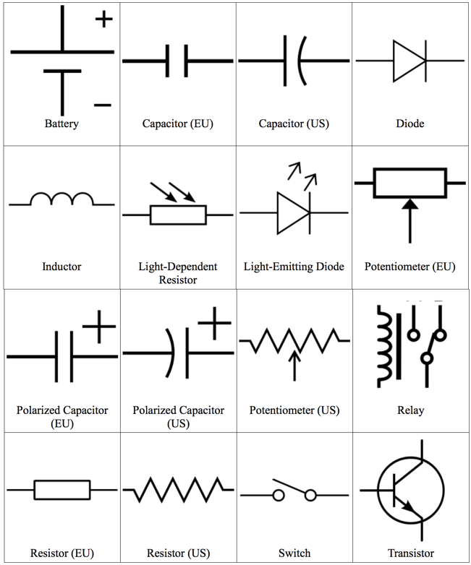

Slide 11
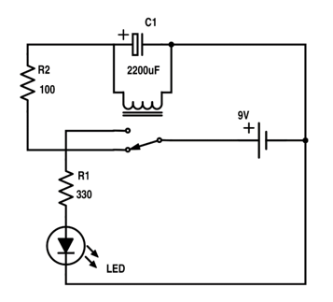
Blinking Light Schematic

Slide 12
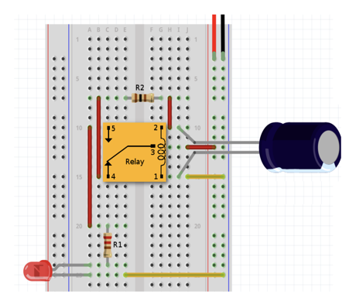
Blinking Light In Detail

